Slide 1
Identifying the Lattice Parameters
(In your groups) determine the lattice vectors and basis for the smallest possible unit cell (more than one possible answer)
If you finish, draw the lattice.

Slide 2
Identifying the Lattice Parameters
(In your groups) determine the lattice vectors and basis for the smallest possible unit cell (more than one possible answer)
If you finish, draw the lattice.

Slide 3
Identifying the Lattice Parameters
(In your groups) determine the lattice vectors and basis for the smallest possible unit cell (more than one possible answer)
If you finish, draw the lattice.
a) Situation of atoms at the corners of regular hexagons

Slide 4
Identifying the Lattice Parameters
(In your groups) determine the lattice vectors and basis for the smallest possible unit cell (more than one possible answer)
If you finish, draw the lattice.
y
a₂
α
O
x
a₁
a) Situation of atoms at the corners of regular hexagons
b) Crystal lattice obtained by identifying all the lattice points in (a)

Slide 5
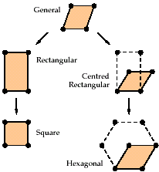
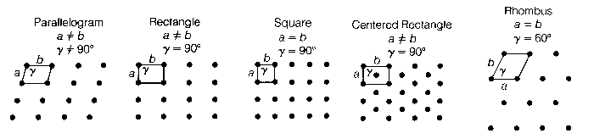
Bravais Lattices in 2D
Special case where angles go to 90°
parallelogram
Special case where point halfway
In 2D there are five ways to order atoms in a lattice
a=b
a=b
Notes:
More common to use non-primitive in 3d (next slide)

Slide 6
Bravais Lattices in 2D
A Bravais lattice looks the same from any lattice point.
Special case where angles go to 90°
parallelogram
Special case where point halfway
In 2D there are five ways to order atoms in a lattice
Primitive unit cell: contains only one lattice point (but 4 points?)
Are the dotted lattices primitive?
  Non-primitive unit cells sometimes useful if orthogonal coordinate system can be used
a=b
a=b
Notes:
More common to use non-primitive in 3d (next slide)

Slide 7
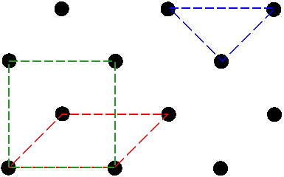
Why can't the blue triangle be a unit cell?
Not primitive
Notes:
When it translates, it has to cover all space in the crystal. There are three axes here; you can’t even pick two vectors.

Slide 8
Defining a lattice means writing lattice vectors
A Bravais lattice is a set of points such that a translation from any point in the lattice by a vector;
R = u₁ a₁ + u₂ a₂
locates an exactly equivalent point, i.e. a point with the same environment. This is translational symmetry.
1. It should cover the whole space.
2. In 2D, there should be only 2 vectors.
What would they be here?

Slide 9
You can define a vector by its lattice points. (More on this later.)
Not primitive
If the start of the vector is at (0,0), what lattice point would this be?
(0,0)
A Bravais lattice is a set of points such that a translation from any point in the lattice by a vector;
R = u₁ a₁ + u₂ a₂
locates an exactly equivalent point, i.e. a point with the same environment.
Notes:
When it translates, it has to cover all space in the crystal. There are three axes here; you can’t even pick two vectors.

Slide 10
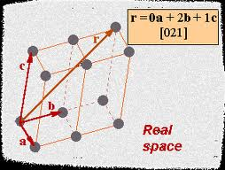
Lattice Vectors – 3D
A three dimensional crystal is described by 3 fundamental translation vectors a, b and c (AKA: a₁, a₂ and a₃)
r = u₁ a + u₂ b + u₃ c
Also common:
R = h a₁ + k a₂ + l a₃
Sometimes people will use [h k l] instead of u’s.
(more common to see in reciprocal space, later)
Notes:
Again, calling stuff by different names can be very confusing, particularly in this field.
Kittel uses a1, a2 and a3

Slide 11
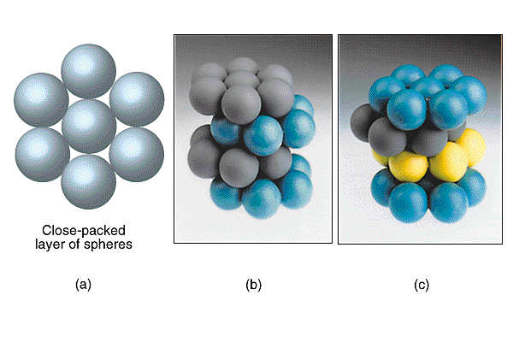
Solid Models: Close-Packed Spheres
Many atoms or ions forming solids have spherical symmetry (e.g. noble gases and simple metals)
Considering the atoms or ions as solid spheres we can imagine crystals as closely packed spheres
How can we pack them?

Slide 12
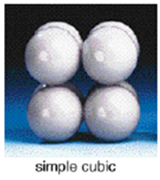
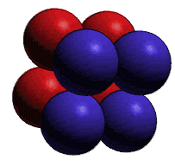
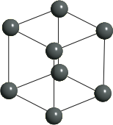
Simple cubic
R = u₁ a + u₂ b + u₃ c
a
b
c
The simple cubic structure is a Bravais lattice.
How many lattice points are in each unit cell?
Notes:
Bravais lattice means that when you move along any lattice vectors, the resulting symmetry/environment is exactly the same

Slide 13
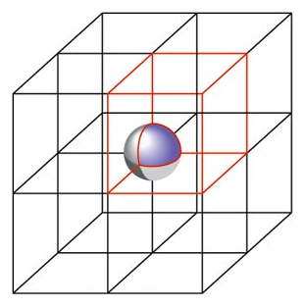
Simple cubic
We can also simply count the lattice points we see in one unit cell.
But we have to keep track of how many unit cells share these atoms.
1/8 atom
1/8 atom
1/8 atom
1/8 atom
1/8 atom
1/8 atom
1/8 atom
1/8 atom
Notes:
another way of viewing this: count all the atoms in the unit cell
keep track of atom sharing!
also gives one atom
easier: construct cubic box around one atom!

Slide 14
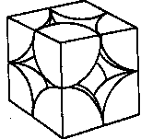
ATOMIC PACKING FACTOR (APF)
a

Slide 15
ATOMIC PACKING FACTOR (APF)
a
R=0.5a
close-packed directions (where they touch)
Lattice constant
contains 8 x 1/8 =
1
atom/unit cell

Slide 16
ATOMIC PACKING FACTOR (APF)
a
R=0.5a
close-packed directions (where they touch)
contains 8 x 1/8 =
Lattice constant
1
atom/unit cell

Slide 17
ATOMIC PACKING FACTOR (APF)
a
R=0.5a
close-packed directions (where they touch)
contains 8 x 1/8 =
1
atom/unit cell
Lattice constant
APF for the simple cubic structure = 0.52

Slide 18
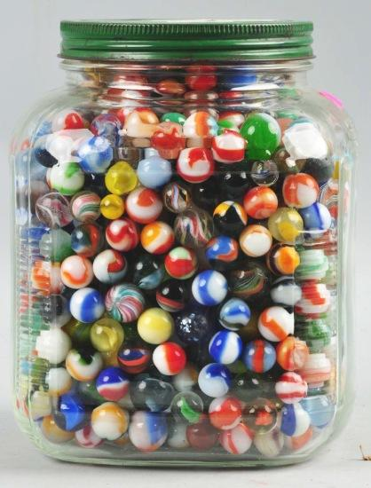
Simple cubic
A simple cubic structure is not efficient at packing spheres (atoms occupy only 52% of the total volume). Marbles will not resemble.
Only one single element crystallizes in the simple cubic structure (polonium). More multi-elements.
Notes:
If we took a bunch of marbles, we wouldn’t expect to see them stack this way.
Po is a rare metal

Slide 19
How Else Can We Stack
How else might be a way to stack up these marbles that represent atoms?
Notes:
Hard to keep cubic. Too easier tilted. Compare to triangular lattice.

Slide 20
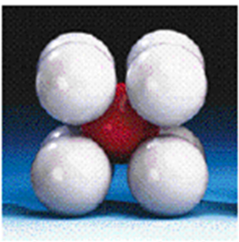
How Else Can We Stack
How else might be a way to stack up these marbles that represent atoms?
Often drawn as different colors (for easy viewing) but these are NOT different atoms!
Notes:
Hard to keep cubic. Too easier tilted. Compare to triangular lattice.

Slide 21
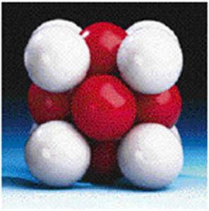
How Else Can We Stack
How else might be a way to stack up these marbles that represent atoms?
Often drawn as different colors (for easy viewing) but these are NOT different atoms!
Notes:
Hard to keep cubic. Too easier tilted. Compare to triangular lattice.

Slide 22
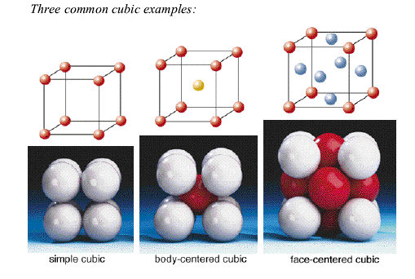
Let’s count the number of atoms
Vertex(corner) atom shared by 8 cells ⇒ ¹/₈ atom per cell
Notes:
In groups: Discuss # of atoms per cell
These are all lattice points and the definition of a lattice point is that the environment has to be the same as all other lattice points.
IF THEY WERE DIFFERENT ATOMS, THIS WOULD NOT BE THE SAME STRUCTURE.

Slide 23
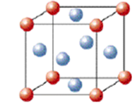
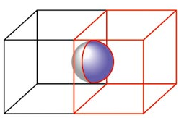
# of Lattice points/Unit Cell
Face Centered Cubic (FCC)

Slide 24
# of Lattice points/Unit Cell
For atoms in a cubic unit cell:
Points on faces are ½ within the cell
Points on Faces
Face Centered Cubic (FCC)

Slide 25
# of Lattice points/Unit Cell
For atoms in a cubic unit cell:
Points on faces are ½ within the cell
How many full atoms are in this cube?
Face Centered Cubic (FCC)

Slide 26
Three Cubic Unit Cell Types in 3D
Vertex(corner) atom shared by 8 cells ⇒ ¹/₈ atom per cell
Edge atom shared by 4 cells ⇒ ¹/₄ atom per cell
Face atom shared by 2 cells ⇒ ¹/₂ atom per cell
Body unique to 1 cell ⇒ 1 atom per cell
Notes:
Discuss/draw edge and unit cells to help visualize (draw on sc for simplicity)
In groups: Discuss # of atoms per cell

Slide 27
Three Cubic Unit Cell Types in 3D
Are these primitive unit cells?
Vertex(corner) atom shared by 8 cells ⇒ ¹/₈ atom per cell
Edge atom shared by 4 cells ⇒ ¹/₄ atom per cell
Face atom shared by 2 cells ⇒ ¹/₂ atom per cell
Body unique to 1 cell ⇒ 1 atom per cell
Notes:
In groups: Discuss # of atoms per cell

Slide 28

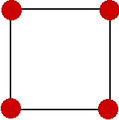
UNIT CELLS
Primitive
Single lattice point per cell
Smallest area in 2D, or
Smallest volume in 3D
Simple cubic(sc)
Conventional = Primitive cell
Notes:
Common to get confused and think there should be only one atom per unit cell, but there can be multiple atoms in a basis!

Slide 29
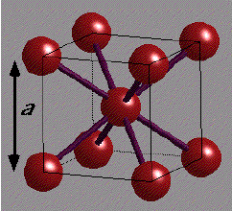
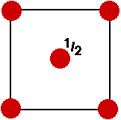
UNIT CELLS
Primitive
Conventional & Non-primitive
Single lattice point per cell
Smallest area in 2D, or
Smallest volume in 3D
More than one lattice point per cell
Integral multiples of the
area/volume of primitive cell
Simple cubic(sc)
Conventional = Primitive cell
Body centered cubic(bcc)
Conventional ≠ Primitive cell
Notes:
Common to get confused and think there should be only one atom per unit cell, but there can be multiple atoms in a basis!

Slide 30
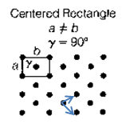
UNIT CELLS
Primitive
Conventional & Non-primitive
Single lattice point per cell
Smallest area in 2D, or
Smallest volume in 3D
More than one lattice point per cell
Integral multiples of the
area/volume of primitive cell
Simple cubic(sc)
Conventional = Primitive cell
Body centered cubic(bcc)
Conventional ≠ Primitive cell
Notes:
Common to get confused and think there should be only one atom per unit cell, but there can be multiple atoms in a basis!

Slide 31
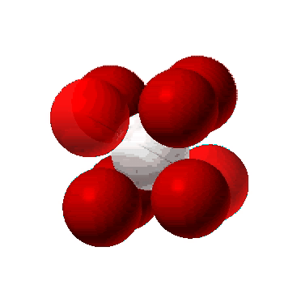
BODY CENTERED CUBIC STRUCTURE (BCC)
What is the close packed direction?
a
--Note: All atoms are identical; the center atom is shaded differently only for ease of viewing.
Notes:
Along the diagonal

Slide 32
BODY CENTERED CUBIC STRUCTURE (BCC)
What is the close packed direction?
APF for simple cubic:
a
What kind of adjustments would we make to calculate the atomic packing factor?
Notes:
Along the diagonal

Slide 33
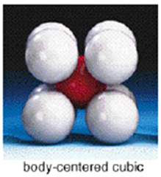
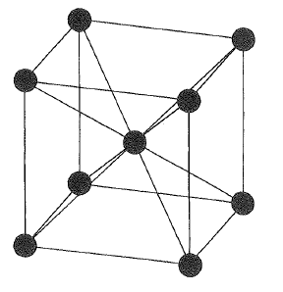
Better packing than SC
In the body-centred cubic (bcc) structure 68% of the total volume is occupied.
Next-nearest neighbors relatively close by – make structure stable in some instances. Examples: Group I metals, Ba, V, Nb, Ta, W, Mo, Cr, Fe
Is this cube a primitive lattice?
Notes:
How would you select a primitive unit cell? What volume should it have? (half of the conventional as there are 2 atoms in the conventional cubic cell). Select primitive lattice vectors along the body diagonals (they will not be orthogonal).
Easy to see why easier to use orthogonal convention lattice.

Slide 34
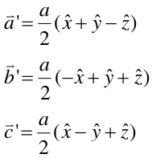
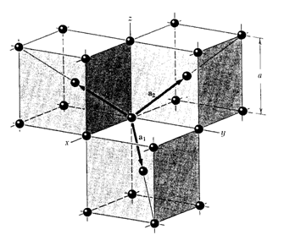
Better packing than SC
In the body-centred cubic (bcc) structure 68% of the total volume is occupied.
Next-nearest neighbors relatively close by – make structure stable in some instances. Examples: Group I metals, Ba, V, Nb, Ta, W, Mo, Cr, Fe
Is this cube a primitive lattice?
No. The bcc structure is a Bravais lattice but the edges of the cube are not the primitive lattice vectors. Not smallest Vol.
Notes:
How would you select a primitive unit cell? What volume should it have? (half of the conventional as there are 2 atoms in the conventional cubic cell). Select primitive lattice vectors along the body diagonals (they will not be orthogonal).
Easy to see why easier to use orthogonal convention lattice.

Slide 35
Better packing than SC
How does the volume of the bcc primitive cell compare to the volume of the conventional cell?
Notes:
It is half the volume

Slide 36
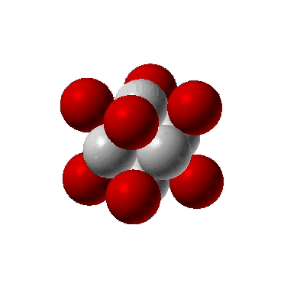
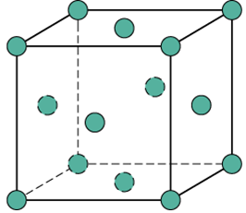
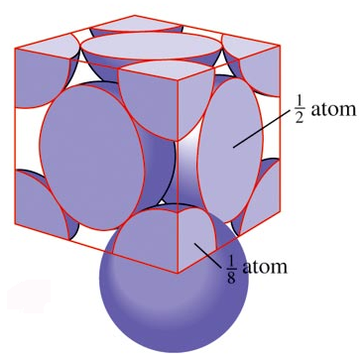
FACE CENTERED CUBIC STRUCTURE (FCC)
What is the close packed direction?
Note: All atoms are identical; the face-centered atoms are shaded differently only for ease of viewing.

Slide 37
FACE CENTERED CUBIC STRUCTURE (FCC)
What are the lattice directions of the primitive unit cell?
Note: All atoms are identical; the face-centered atoms are shaded differently only for ease of viewing.

Slide 38
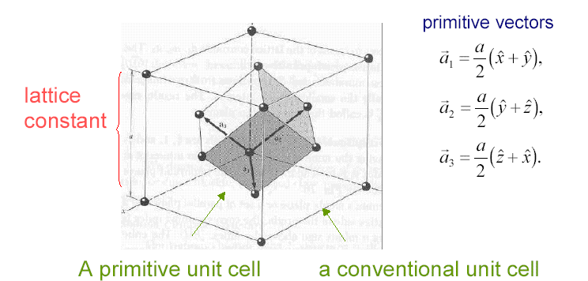
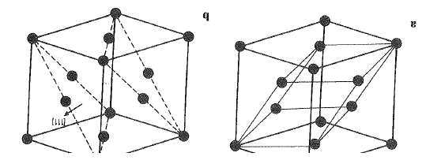
Simple Crystal FCC
Another view
Notes:
Part of 2V2

Slide 39
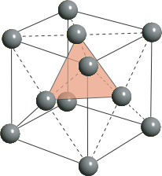
Simple Crystal FCC
Another view
Notes:
Part of 2V2

Slide 40
Simple Crystal FCC
How does the volume of the fcc primitive cell compare to the volume of the conventional cell?
Another view
Notes:
Part of 2V2

Slide 41
Groups: Fill in this Table for Cubic Structures
 | SC | BCC | FCC
Volume of conventional cell | a³ | a³ | a³
# of atoms per cubic cell | 1 | 2 | 4
Volume, primitive cell | a³ | ½ a³ | ¼ a³
# of nearest neighbors | 6 | 8 | 12
Nearest-neighbor distance | a | ½ a √3 | a/√2
# of second neighbors | 12 | 6 | 6
Second neighbor distance | a√2 | a | a
Notes:
If running low on time, only have them figure out number of nearest neighbors
While they still have their magnetic blocks
Mention that # NN=coordination number

Slide 42
Groups: Fill in this Table for Cubic Structures
 | SC | BCC | FCC
Volume of conventional cell | a³ | a³ | a³
# of atoms per cubic cell | 1 | 2 | 4
Volume, primitive cell | a³ | ½ a³ | ¼ a³
# of nearest neighbors | 6 | 8 | 12
Nearest-neighbor distance | a | ½ a √3 | a/√2
# of second neighbors | 12 | 6 | 6
Second neighbor distance | a√2 | a | a
Notes:
If running low on time, only have them figure out number of nearest neighbors
While they still have their magnetic blocks
Mention that # NN=coordination number

Slide 43
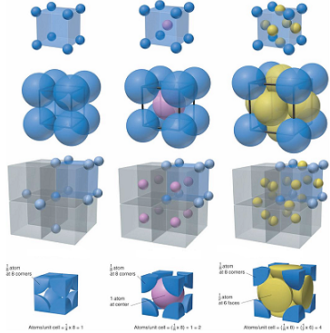
Primitive cubic
Body centered cubic
Face centered cubic
Coordination number
6
8
12

Slide 44
Groups: Fill in this Table for Cubic Structures
 | SC | BCC | FCC
Volume of conventional cell | a³ | a³ | a³
# of atoms per cubic cell | 1 | 2 | 4
Volume, primitive cell | a³ | ½ a³ | ¼ a³
# of nearest neighbors | 6 | 8 | 12
Nearest-neighbor distance | a | ½ a √3 | a/√2
# of second neighbors | 12 | 6 | 6
Second neighbor distance | a√2 | a | a
Notes:
If running low on time, only have them figure out number of nearest neighbors
While they still have their magnetic blocks
Mention that # NN=coordination number

